Slide 1
Days of Knowledge Central 2023
Create and Publish your Power Virtual Agent in less than 30 Minutes !
Samir Daoudi | Power Platform Architect @ LogiSam ltd

Slide 2
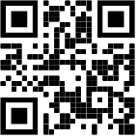
Samir Daoudi – Power Platform Architect
18 Microsoft Certifications, Power Platform, SharePoint, M365, SQL Server & .NET.
13 Years' Experience with Microsoft Technologies Stack.
Blogger and Technology enthusiast.
https://www.daoudisamir.com​
@daoudi_samir
https://www.linkedin.com/in/samir-daoudi-92b19330/

Slide 3
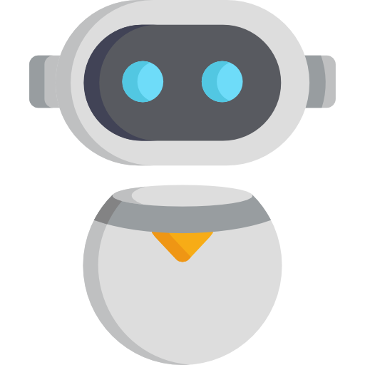
Microsoft believes that the defining characteristic of a chatbot is its conversational interface. Whether you communicate with it through typing or speaking, you and the chatbot interact in natural language.
They reduce costs by providing automated responses to common requests. For example, a chatbot might let users schedule an appointment, update an order, or do other tasks.
They improve customer satisfaction by letting your customers resolve issues on their own around the clock.
What is a Chat bot ?

Slide 4
Power Virtual Agents is a new technology from Microsoft that empowers anyone in your business to build versatile, adaptable chatbots, with no coding or AI expertise required. Power Virtual Agents can help with everything from HR to sales, on almost any site or channel imaginable—from websites to Microsoft Teams to Facebook to Microsoft Power Apps.
Power Virtual Agents makes chatbots easy to build, and you can be up and running with your first one within minutes.
Power Virtual Agents

Slide 5
Why PVAs ?
Power Virtual Agents is easy and intuitive to use, featuring a visual authoring canvas designed with business people in mind
You can be up and running fast with your first chatbot right out of the box.
Chatbots created with Power Virtual Agents use a universal language model trained on a huge amount of data and optimized for the way people use language when interacting with chatbots.
You can embed your chatbots across dozens of different channels. You might deploy one, for engaging with customers, on your website, Facebook, or Skype.
No Code required
Get started in minutes
Intelligent interactions
Deployable almost anywhere

Slide 6
So, how long does it take to build a PVA ?
Sounds interesting right ?
So, how long would it take to build a Power Virtual Agent ?
Demo Time !

Slide 7
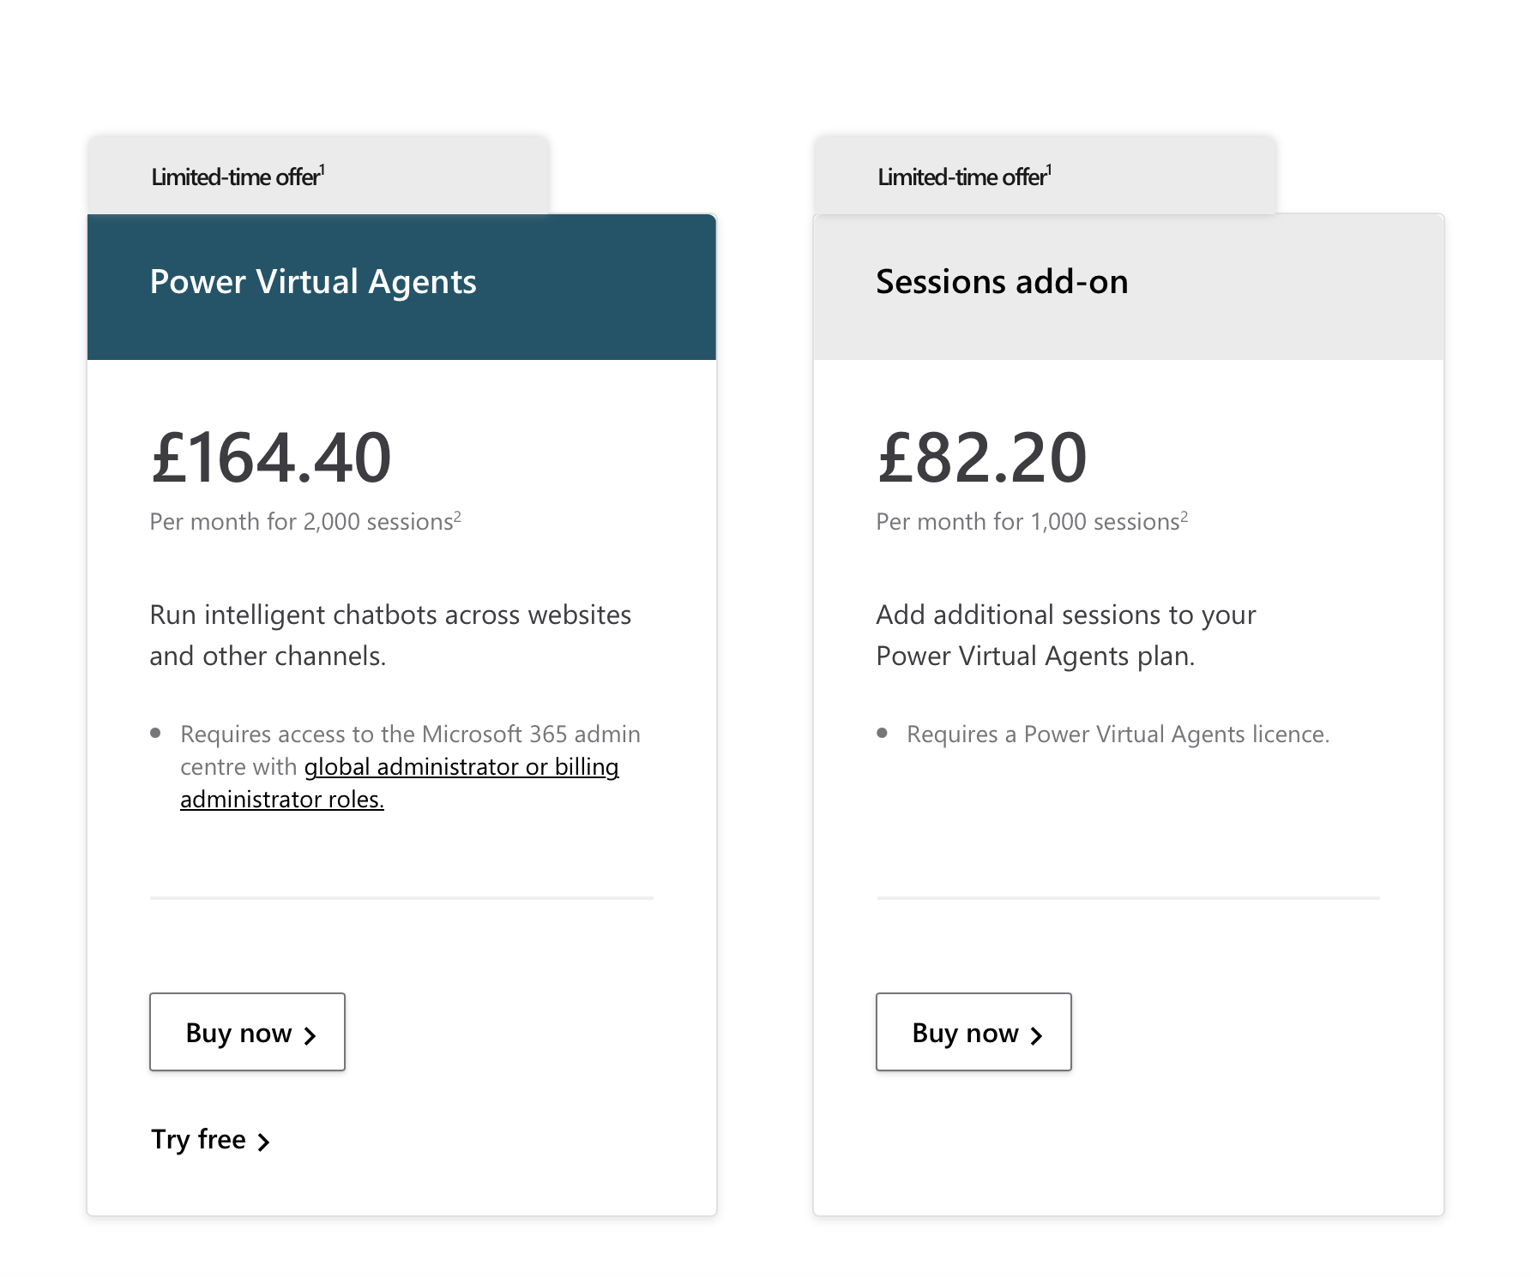
Cost ?
https://powervirtualagents.microsoft.com/en-gb/pricing/
What’s included
Sessions | 2,000 per month³
Use Microsoft Dataverse (formerly Common Data Service) | 10 GB database capacity⁴
 | 20 GB file capacity⁴
Enable your bot to take actions | Power Automate use rights⁵

Slide 8
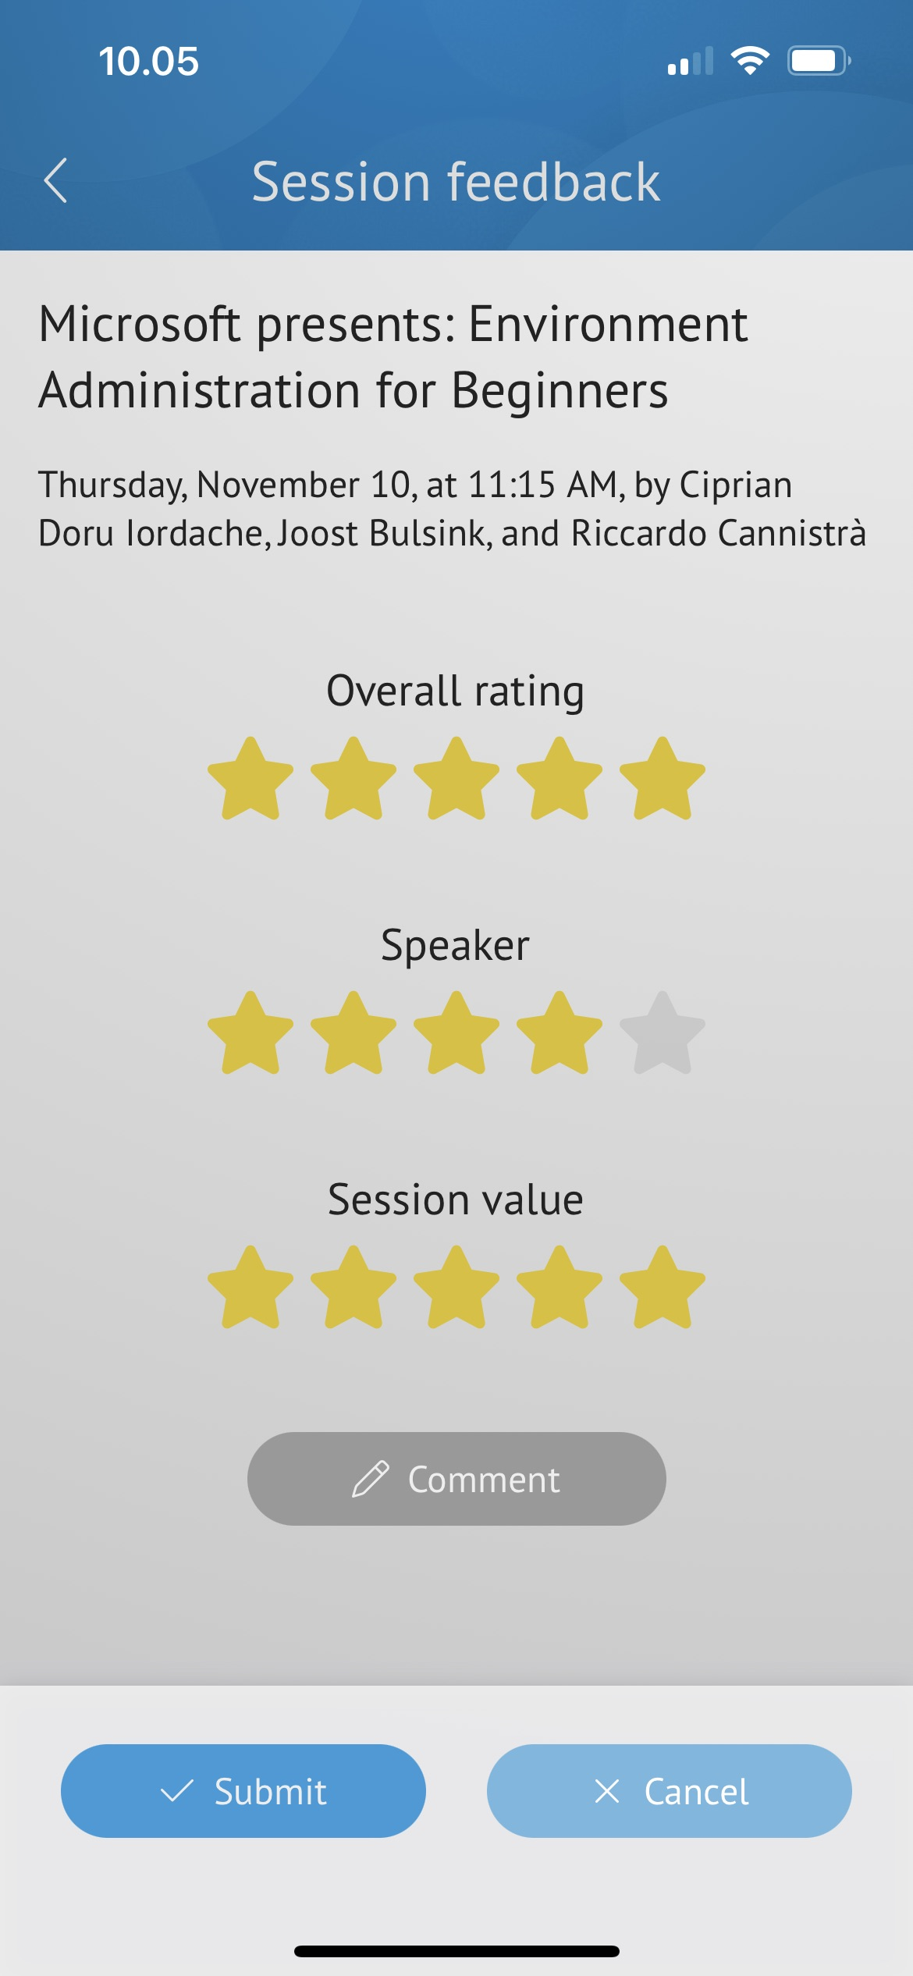
Thank you !
Please rate the session in the Conference App !

