Slide 1
Microsoft 365 & Power Platform Development Community Call.
Create and publish your first PVA in less than 30 minutes
22nd June 2023
https://samtech365.com/create-your-first-power-virtual-agent-hr-bot/

Slide 2
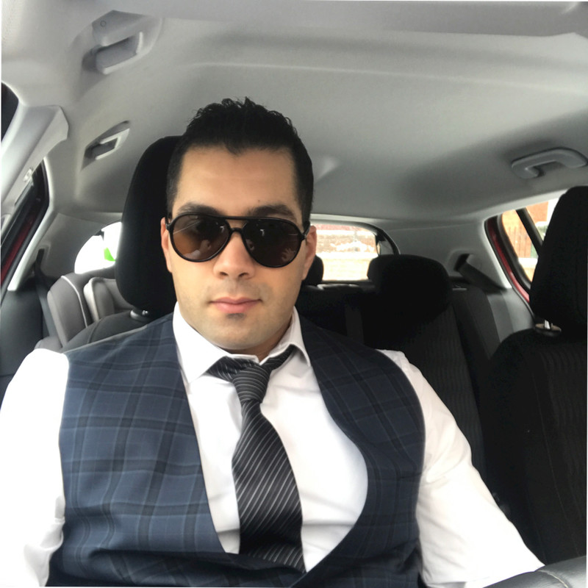
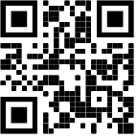
Samir Daoudi – Power Platform Architect
18 Microsoft Certifications, Power Platform, SharePoint, M365, SQL Server & .NET.
13 Years' Experience - Microsoft Technologies Stack.
Blogger and Technology enthusiast.
https://www.daoudisamir.com​
@daoudi_samir
https://www.linkedin.com/in/samir-daoudi-92b19330/

