Slide 1
Days of Knowledge Central 2023
Power Apps Performances Optimisation
Samir Daoudi | Power Platform Architect @ LogiSam Ltd

Slide 2
Samir Daoudi – Power Platform Architect
18 Microsoft Certifications, Power Platform, SharePoint, M365, SQL Server & .NET.
13 Years' Experience with Microsoft Technologies Stack.
Blogger and Technology enthusiast.
https://www.daoudisamir.com​
@daoudi_samir
https://www.linkedin.com/in/samir-daoudi-92b19330/

Slide 3
The problem !
Do More with Less ☹
Rapid Development
Power Users or Power Builders
“Pseudo” Agile environments
Lack of Governance and visibility
What Impacts your Power Apps Solutions
The Choice of the data source
Data in Memory
X-Screens references
Media Objects
Recommendations
Agenda !

Slide 4
1. Do more with less
2. Rapid development
3. Power Users and Power ‘builders’
4. ”Pseudo”- Agile environments
5. Lack of governance and visibility
The Problem ?

Slide 6
1. Do more with less !
Microsoft encourages the “Do more with less” approach.
This approach helps building amazing solutions in no time
The downside of such approach are:
Lack of planning
Poor data architecture
End up re-structuring data sources frequently to adapt to the continuous requirements changes.

Slide 8
2. Rapid development
Solutions build time has been reduced drastically.
Organizations' expectations are quiet high.
In many instances, build time and rapid releases are the priority instead of the quality of the solution.

Slide 10
3. Power Users and Power ‘builders’
Many non-it users are tempted to build business’ critical solution.
The lack of understanding of the fundamentals of software engineering building blocks (memory management, dependencies, variables scopes …etc.)
Lack of understanding of the security models and implications.
Very little considerations for the data loss risks, and data exposure.

Slide 12
4. ”Pseudo”- Agile environments
Agile is a methodology, not just ”quick and iterative releases”.
A lot of Agile’s aspects end up missed or miss-interpreted and the whole Agile methodology summarizing in “let’s just release this version !”

Slide 14
5. Lack of governance and visibility
Many companies are focused on releasing the next “shinny” tool.
The fact that anyone can create applications & environments, end up creating a huge mess and a “shadow IT” world.
Usually, companies and IT departments only wakes up, when something get wrong.
A simple tool such as the COE ”Center of Excellence” can at least mitigate and impose a minimum governance model, and help starting the discussion around this issue.

Slide 15
What impacts our Power Apps Performances ?
Choice of data source
Amount of data in memory
Cross-screens controls references
Media Objects

Slide 16
1. Choice of the right Data Source
Users have access to different data sources when it comes to building their Power Apps solutions.
Data Verse
SharePoint Online
Sql Server (Azure or on-Prem*)
Excel Spreadsheets in one drive

Slide 17
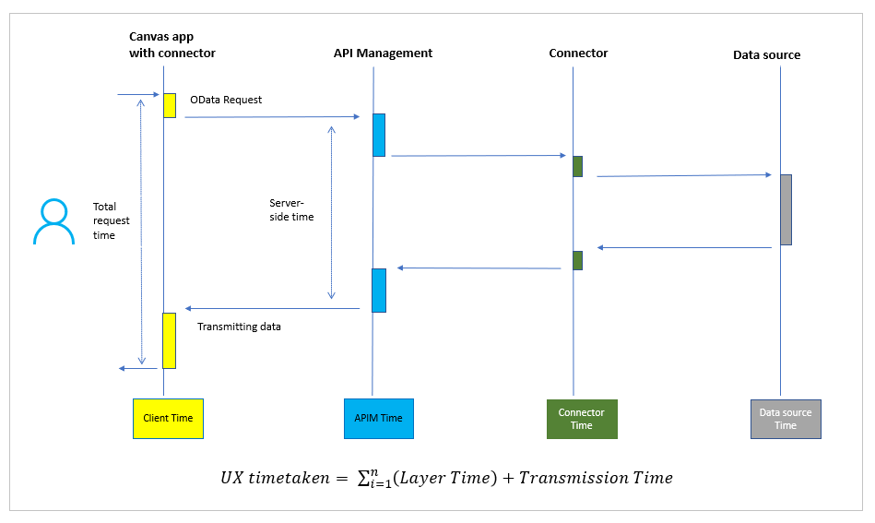
Number of Data calls (requests/responses) for SharePoint, Excel Files, or SQL Azure
https://learn.microsoft.com/en-us/power-apps/maker/canvas-apps/execution-phases-data-flow

Slide 18
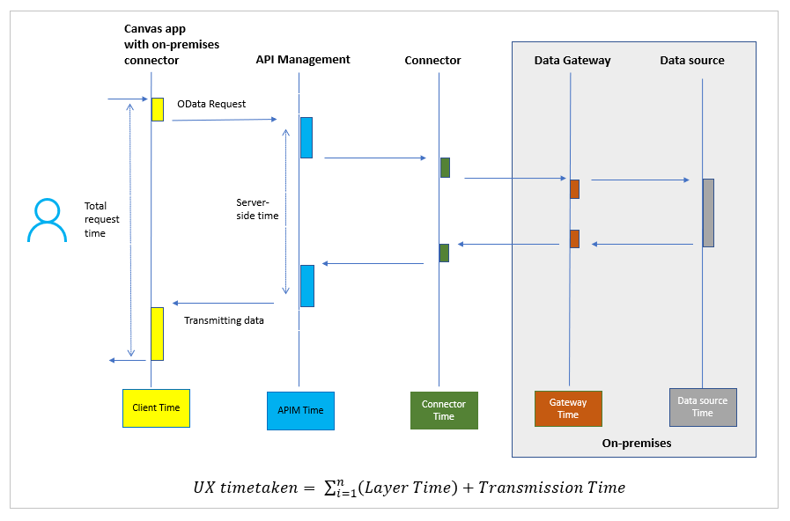
Calls to On prem data sources
https://learn.microsoft.com/en-us/power-apps/maker/canvas-apps/execution-phases-data-flow

Slide 19
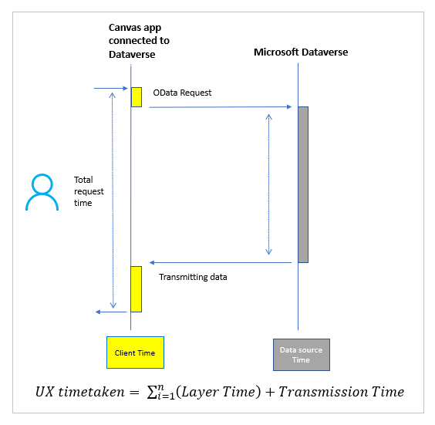
Data Verse !
https://learn.microsoft.com/en-us/power-apps/maker/canvas-apps/execution-phases-data-flow

Slide 20
2. Amount of data in memory
Power Apps has a limit of 500-2000 rows in collections.
Some users end up merging X number of 2000 rows’ collections to load larger data sets.
Doing this in the App.OnStart event has drastic consequences when it comes to the app loading time.
You should never need to load that amount of data in memory, even 2K rows is a lot ! Review your Ui/Ux.

Slide 21
What should be done !
Load the data in the screens required (delay load).
Only load what is needed.
Use delegable filters (such as StartsWith).
Use indexes whenever possible.
Avoid any heavy data loads in the App.On Start

Slide 22
3. Cross-screens controls references
When duplicating screens, some formulas (Height, Width, X, Y …etc.) might still reference the initial screens.
Rendering screens which references other screens requires the “in-memory” rendering of the initial screens to evaluate the formulas, which leads to unnecessary load times.

Slide 23
Best practices
You should not reference other screens’ controls in any formula !
Keep the controls properties (Width, Heights …etc.) formulas simple.
Use containers to manage more efficiently your UI responsivity side.
Limit the number of controls in each screen.
Just keep it simple !

Slide 24
4. Media Objects
Media objects or images, add up to the overall application size. Which in turns impacts the load time.
We have a limit of 200 Mb for the Applications assets.

Slide 25
How to handle media objects ?
Upload the images in the resolution required, i.e. if you want to use an image as 32x32 px icon, no need to upload the image in a higher resolution.
Use SVGs as much as possible.
Only upload media files that are used in the application screens, in other words, clean your media list of any unused objects.

Slide 26
Other considerations
Number of Data connections → Use only what your app needs !
Use parallel processing → Concurrent
Use delegation whenever possible.
Cache data which you will need to reuse
Reduce the overall processing load in the App.On Start
Delayed Loading → For large applications
Avoid duplicating similar formulas for different controls.

Slide 27
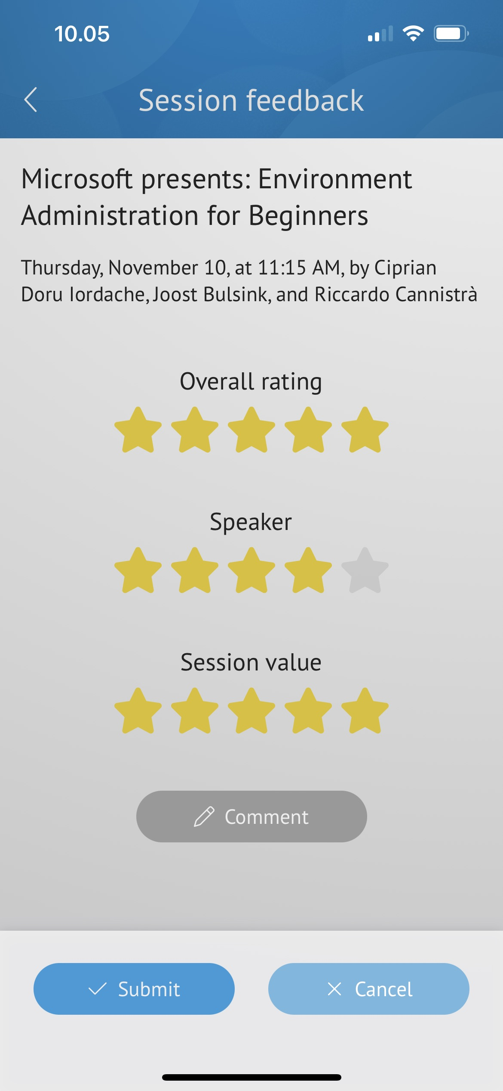
Thank you !
Please rate the session in the Conference App !
https://www.daoudisamir.com​
@daoudi_samir
https://www.linkedin.com/in/samir-daoudi-92b19330/

