Slide 1
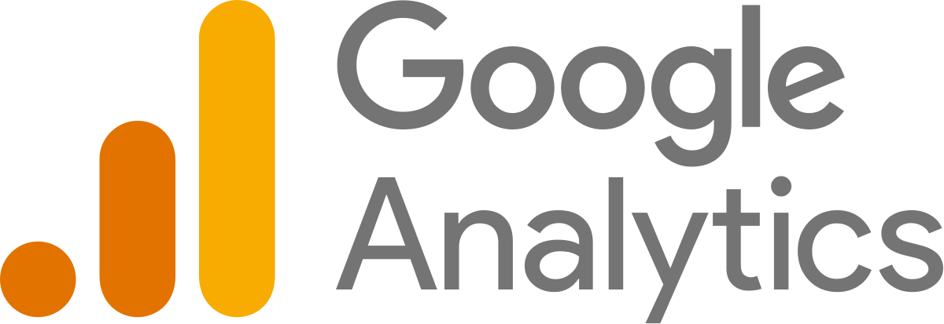
Viva Connection and SharePoint Framework Bi-Weekly Community Call
Track your Modern SharePoint Site Usage with Google Analytics
29th June 2023
https://samtech365.com/track-your-modern-sharepoint-site-usage-with-google-analytics/

Slide 2
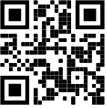
Samir Daoudi – Power Platform Architect
18 Microsoft Certifications, Power Platform, SharePoint, M365, SQL Server & .NET.
13 Years' Experience - Microsoft Technologies Stack.
Blogger and Technology enthusiast.
https://www.daoudisamir.com​
@daoudi_samir
https://www.linkedin.com/in/samir-daoudi-92b19330/

Slide 3
Demo Steps / Agenda
Create a Google Analytics Property and retrieve the tracking ID
Scaffold an SPFx Application Customized project
Overwrite the OnInit property to inject the Google Analytics Script
Bundle and package the SPPKG solution.
Upload to the SharePoint App Catalogue and let it shine !

